Slide 1
The Future Direction of Information Visualization
Graphical Perceptions
Data Analytics
Machine Learning
Here we begin to understand, asses and propose

Slide 2
01
02
03
Graphics
Data
Machine Learning
Graphical Perceptions are a huge factor in the way data is interpreted by users
Data analytics is a force to be reckoned with when it comes providing strategic insight for innovation and competition
Opportunities and challenges exist between the successful merging of ML and Data analytics

Slide 3
Haley Waddell UNCC Student
This presentation has been constructed to provide an overlay of my research paper:
The Future Direction of Information Visualization

Slide 5
“Sharing knowledge is also a form of teaching. Being able to publish information so easily in this age for others to be able to tap into is one way to accomplish this, and is gratifying, as well”
—Tobias J. Kreidl

Slide 6
Graphics
01
Graphical perception: What is being shared and how is it being correlated to the user matters…A LOT

Slide 7
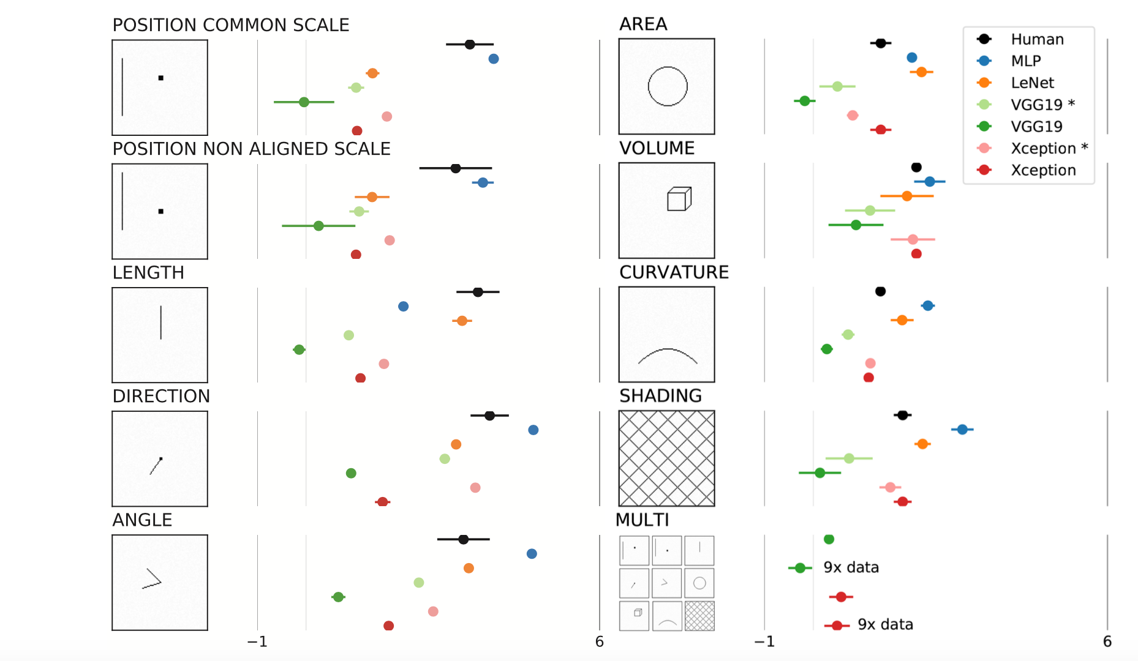
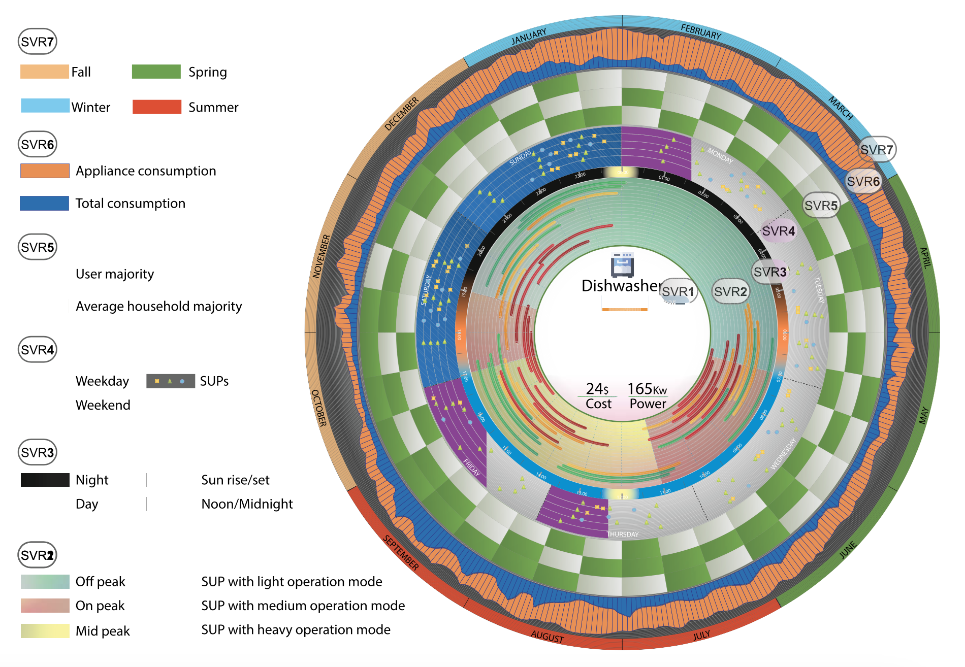
Key factors in Graphical Representation
Color Perception[2]
Visual Relation[3]
Pattern recognition[4]

Slide 8
Data
02
Data analysis aims to make the intangible and difficult to analyze data sets quantifiable for the human mind and eye.

Slide 9
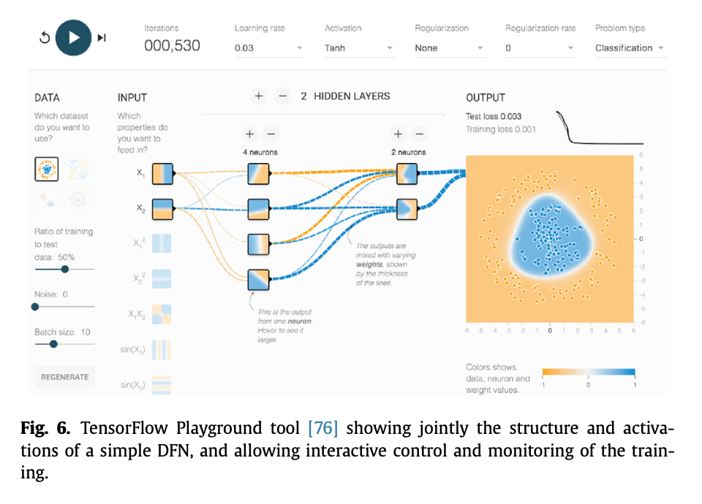
Key factors in Data Analysis
Sense-Making power[8]
Useful features[9]
Forecasting the what-if [12]

Slide 10
Machine Learning
03
Visual analytic systems combine machine learning and interactive data to produce analysis…however challenges and opportunities exist.

Slide 11
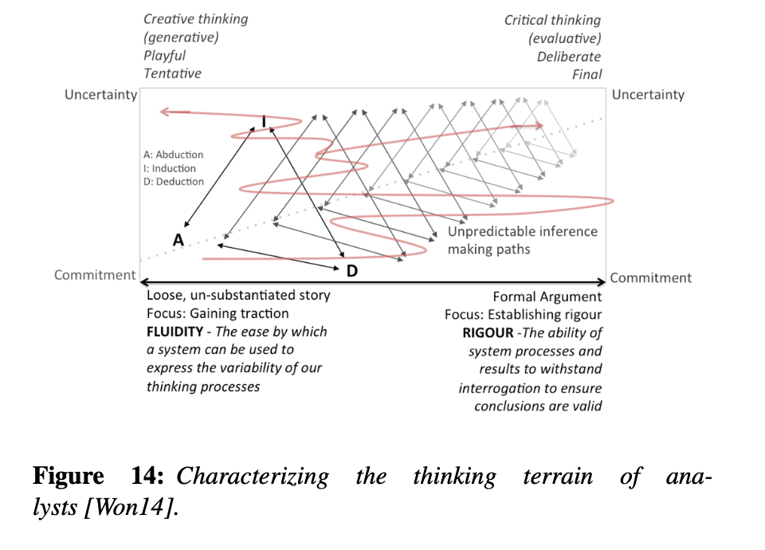
Key factors in Machine Learning
Data scales and complexities increasing[10]
Intersection of ML and Visual Analytics[10]
Supervised and Unsupervised Tasks [10]

Slide 12

Current studies, trends and methods
Depth will be added through discussion of current uses of Visual Analytics

Slide 13
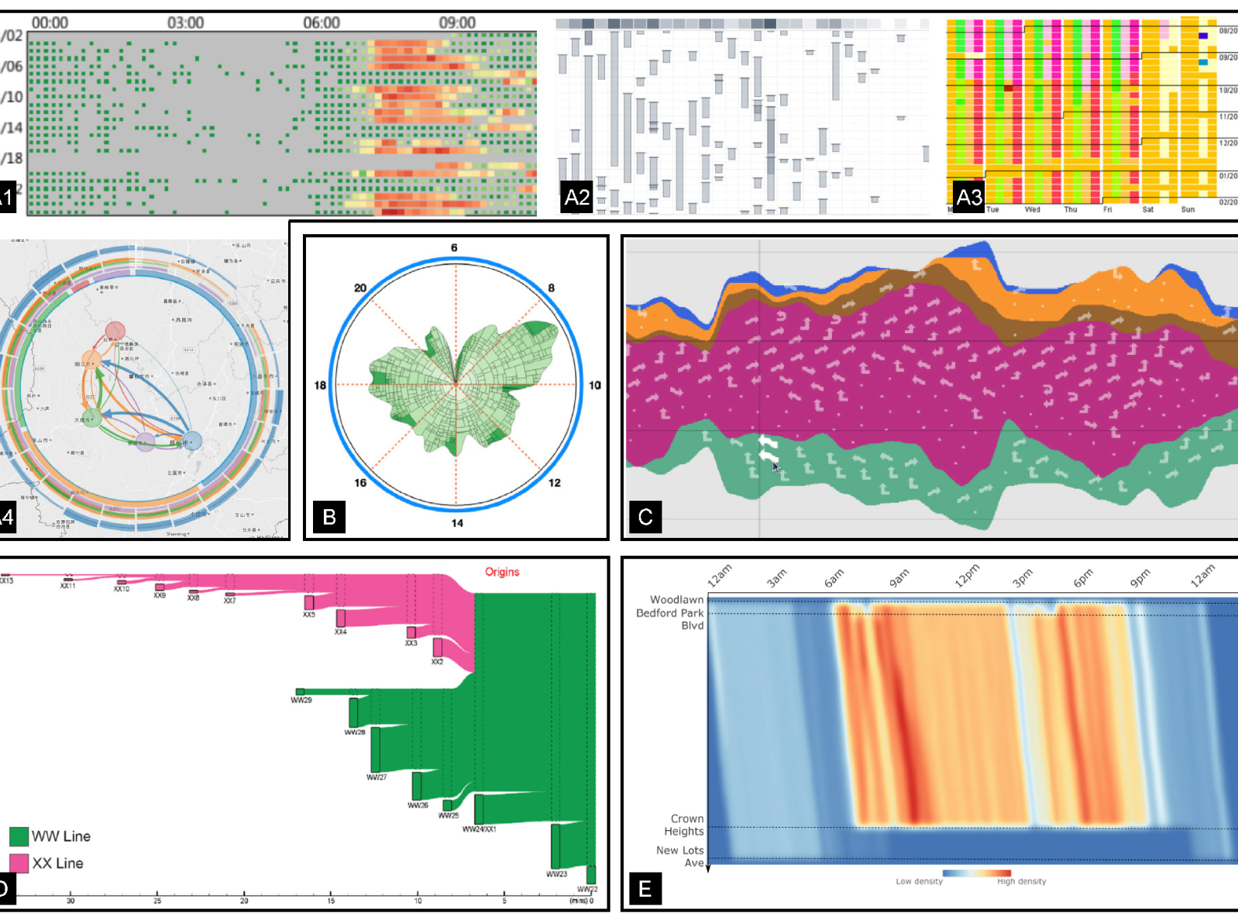
Urban Visual Analytics
This topic will be thoroughly discussed as it is relying on visual analytics to combine forces for further development in the future [12]

Slide 14
The Future Direction of Information Visualization
Sharing knowledge is powerful, doing it effectively takes time, understanding and the willingness to improve

Slide 15
THANKS!
Do you have any questions?
addyouremail@freepik.com
+91 620 421 838
yourcompany.com
Please keep this slide for attribution.

Slide 16
Fonts & colors used
This presentation was made possible by:
https://slidesgo.com/theme/futuristic-background#search-tech&position-7&results-364&rs=search
This presentation has been made using the following fonts:
Montserrat
(https://fonts.google.com/specimen/Montserrat)
#ffab40
#85d5e6
#001633
#ffffff

